Slide 1
Computer Architecture
Sean Hefty
sean.hefty@intel.com

Slide 2
Class Overview
Schedule
Week 1
  Chapters 1-3
Week 2
  Chapters 4-5
Week 3
  Chapters 6-7
Week 4
  Exam 1 – take home, no class

Slide 3
Class Overview
Schedule
Week 5
  Chapters 8-11
Week 6
  Chapters 12-13
Week 7
  Chapters 14-15
Week 8
  Exam 2

Slide 4
Class Overview
Schedule
Week 9
  Chapter 16
Week 10
  Open – catch up week or open topic, such as EPIC architectures
Week 11
  Final exam

Slide 5
Basic Computer
Introduction
Architecture is those attributes visible to the programmer
  Instruction set, number of bits used for data representation, I/O mechanisms, addressing techniques.
  e.g. Is there a multiply instruction?
Organization is how features are implemented
  Control signals, interfaces, memory technology.
  e.g. Is there a hardware multiply unit or is it done by repeated addition?

Slide 6
Basic Computer
Introduction
All Intel x86 family share the same basic architecture
The IBM System/370 family share the same basic architecture
This gives code compatibility
  At least backwards
Organization differs between different versions

Slide 7
Basic Computer
Introduction
Structure is the way in which components relate to each other
Function is the operation of individual components as part of the structure
  Data processing
  Data storage
  Data movement
  Control

Slide 8
Basic Computer
Introduction
Functional view of a computer
Data
Storage
Facility
Data
Movement
Apparatus
Control
Mechanism
Data
Processing
Facility

Slide 9
Basic Computer
Introduction
Data movement
  e.g. keyboard to screen
Data
Storage
Facility
Data
Movement
Apparatus
Control
Mechanism
Data
Processing
Facility

Slide 10
Basic Computer
Introduction
Storage
  e.g. Internet download to disk
Data
Storage
Facility
Data
Movement
Apparatus
Control
Mechanism
Data
Processing
Facility

Slide 11
Basic Computer
Introduction
Processing from/to storage
  e.g. updating bank statement
Data
Storage
Facility
Data
Movement
Apparatus
Control
Mechanism
Data
Processing
Facility

Slide 12
Basic Computer
Introduction
Processing from storage to I/O
  e.g. printing a bank statement
Data
Storage
Facility
Data
Movement
Apparatus
Control
Mechanism
Data
Processing
Facility

Slide 13
Basic Computer
Introduction
Top level structure
Peripherals
Computer
Central
Processing
Unit
Main
Memory
Computer
Systems
Interconnection
Input
Output
Communication
lines

Slide 14
Basic Computer
Introduction
CPU level structure
CPU
Computer
Arithmetic
and
Logic Unit
I/O
Registers
System
Bus
CPU
Internal CPU
Interconnection
Memory
Control
Unit

Slide 15
Basic Computer
Introduction
Control unit level structure
Control Unit
CPU
ALU
Sequencing Logic
Internal
Bus
Control
Unit
Control unit registers and decoders
Registers
Control
Memory

Slide 16
Computer Evolution
Overview
Modern computer designs are based on the following concepts from 1946
  Data and instructions are stored in a single read-write memory
  Memory is addressable without regard to content
  Execution occurs in a sequential fashion unless explicitly modified
The processor accepts control signals that direct the operation of the various digital components
  Control signals are supplied from memory

Slide 17
Computer Evolution
Overview
Operates on binary data
Arithmetic and Logic Unit
Input
Output
Equipment
Main
Memory
Executes instructions
Program Control Unit
Data and Instructions
Structure of IAS Computer
(Institute for Advanced Studies)

Slide 18
Computer Evolution
Overview
1000 x 40 bit words
  Binary number (sign bit plus 39-bit value)
  2 x 20 bit instructions (8-bit opcode, 12-bit address)
Set of registers (storage in CPU)
  Memory Buffer Register
  Memory Address Register
  Instruction Register – 8-bit opcode
  Instruction Buffer Register – rest of instruction
  Program Counter
  Accumulator
  Multiplier Quotient
Details of IAS Computer

Slide 19
Computer Evolution
Overview
Central Processing Unit
Arithmetic and Logic Unit
Accumulator
MQ
Arithmetic & Logic Circuits
Input
Output
Equipment
MBR
Instructions
& Data
Main
Memory
IBR
PC
MAR
IR
Control
Circuits
Program Control Unit
Address

Slide 20
System Buses
Program Concept
Hardwired systems are inflexible
General purpose hardware can do different tasks, given correct control signals
Instead of re-wiring, supply a new set of control signals

Slide 21
System Buses
Program Concept
A sequence of steps
For each step, an arithmetic or logical operation is done
For each operation, a different set of control signals is needed

Slide 22
System Buses
Control Unit Function
For each operation a unique code is provided
  e.g. ADD, MOVE
A hardware segment accepts the code and issues the control signals
We have a computer!

Slide 23
System Buses
Basic Computer Components
The Control Unit and the Arithmetic and Logic Unit constitute the Central Processing Unit
Data and instructions need to get into the system and results out
  Input/output
Temporary storage of code and results is needed
  Main memory

Slide 24
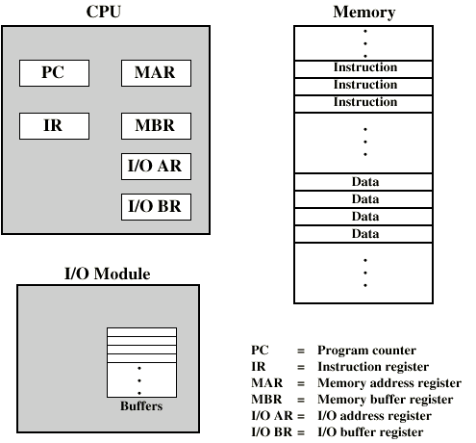
System Buses
Basic Computer Components

Slide 25

System Buses
Instruction Cycle
Two steps:
  Fetch
  Execute

Slide 26
System Buses
Instruction Cycle
Fetch
  Program Counter (PC) holds address of next instruction to fetch
  Processor fetches instruction from memory location pointed to by PC
  Increment PC
    Unless told otherwise
  Instruction loaded into Instruction Register (IR)
  Processor interprets instruction and performs required actions

Slide 27
System Buses
Instruction Cycle
Execution
  Processor-memory
    data transfer between CPU and main memory
  Processor I/O
    Data transfer between CPU and I/O module
  Data processing
    Some arithmetic or logical operation on data
  Control
    Alteration of sequence of operations
    e.g. jump
  Combination of above

Slide 28
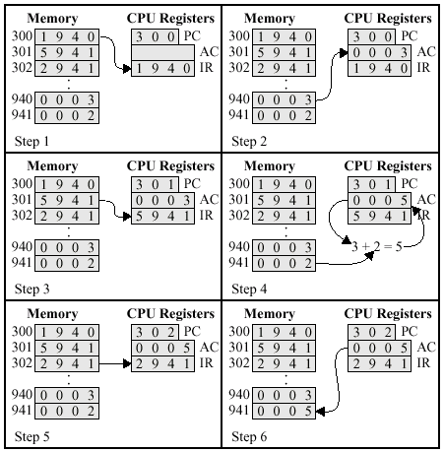
System Buses
Instruction Cycle
Read instr. from address 300
Read contents of address 940 into accumulator
Increment PC and fetch instr.
Add AC and contents of address 941, store in AC
Increment PC and fetch instr.
Save AC to location 941

Slide 29
System Buses
Instruction Cycle
Instructions may involve multiple references to memory
  E.g. Add B, A
May also specify an I/O operation
Following state diagram represents an instruction execution cycle
  Some states may be entered more than once or not at all for any given instruction

Slide 30
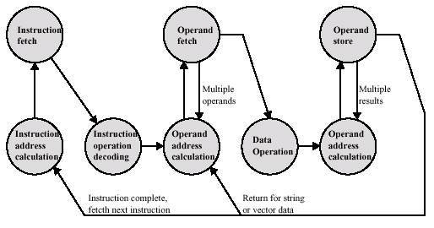
System Buses
Instruction Cycle

Slide 31
System Buses
Instruction Cycle
iac – calculate address of next instruction
  E.g. if instructions are 16 bits and memory is addressable on 2 byte boundaries, add 1
  E.g. if memory is addressable on 1 byte boundaries, add 2
if – read instruction into IR
iod – analyze instruction to determine the type of operation to perform (decode and set the control signals)

Slide 32
System Buses
Instruction Cycle
oac – determine address of any operand in memory or I/O space
of – read any operand into the CPU
do – perform the operation indicated by the instruction
os – write the results to memory or I/O space

Slide 33
System Buses
Interrupts
Processing becomes more difficult with interrupts
  Mechanism used to halt normal processing and change the state of execution
  Primarily used to improve processing times
    Notification versus polling or waiting
Interrupts impact the instruction cycle and the communication between different components
  Not concerned yet with the details of handling interrupts

Slide 34
System Buses
Interrupts
Using interrupts, the processor can engage in executing other instructions while waiting for an operation to complete
  Will be signaled by an interrupt
  Assumes that there is other work to do
An interrupt handler is invoked when the interrupt occurs
  Interrupt changes state of the PC
  Handler is usually part of the OS (ISR – interrupt service routine)

Slide 35
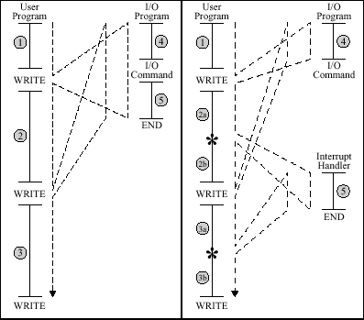
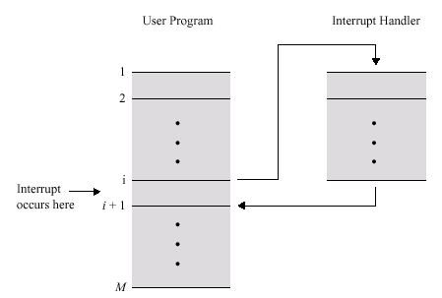
System Buses
Interrupts
continues
waiting
ISR

Slide 36
System Buses
Interrupts
Classes of interrupts:
Program
  e.g. overflow, division by zero, illegal instruction
Timer
  Generated by internal processor timer
  Used in pre-emptive multi-tasking
I/O
  from I/O controller
Hardware failure
  e.g. memory parity error

Slide 37
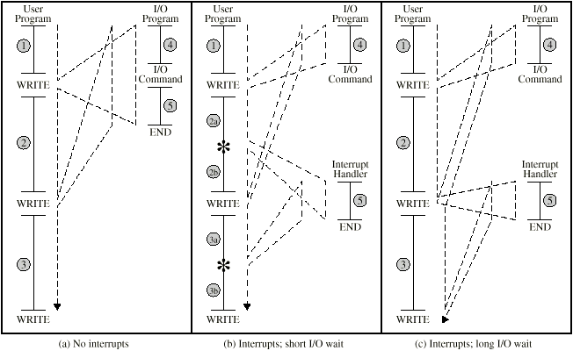
System Buses
Interrupts

Slide 38
System Buses
Interrupts
Added to instruction cycle
Processor checks for interrupt
  Indicated by an interrupt signal
If no interrupt, fetch next instruction
If interrupt pending:
  Suspend execution of current program
  Save context
  Set PC to start address of interrupt handler routine
  Process interrupt
  Restore context and continue interrupted program

Slide 39
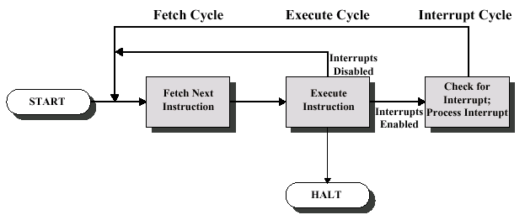
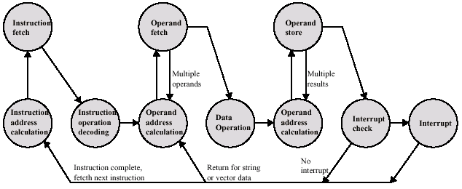
System Buses
Interrupts

Slide 40
System Buses
Interrupts
Disable interrupts
  Processor will ignore further interrupts whilst processing one interrupt
  Interrupts remain pending and are checked after first interrupt has been processed
  Interrupts handled in sequence as they occur
Define priorities
  Low priority interrupts can be interrupted by higher priority interrupts
  When higher priority interrupt has been processed, processor returns to previous interrupt
Handling multiple interrupts

Slide 41

System Buses
Interrupts
Sequential interrupt processing

Slide 42
System Buses
Interrupts
Nested interrupt processing

Slide 43
System Buses
Bus Overview
A communication pathway connecting two or more devices
Usually broadcast
Often grouped
  A number of channels in one bus
  e.g. 32 bit data bus is 32 separate single bit channels
Power lines may not be shown

Slide 44
System Buses
Bus Overview
A bus is a shared communication pathway
  Design for use by multiple devices
  All devices on the bus receive transmitted data
  Only one user may access the bus at a time
  Arbitration determines who gets access

Slide 45
System Buses
Bus Overview
Buses typically consist of 50-200 separate lines, running in parallel
Bus lines can be classified into 3 functional areas
  Data, address, and control (plus power)
Data lines move data between modules
  Typically 8, 16, 32, 64, 128 data lines
  Each data line carries a single bit of data
  Bus width is given in its data line count
Address lines designate the source or destination of the data
Control lines control access and use of others

Slide 46
System Buses
Bus Overview
Examples
  Address line might be an address in memory
  Control line could contain the clock, a command (type of operation to perform), validity of data and address lines, and current bus owner
  If the CPU to memory bus is 16-bits wide, and instructions are 32-bits, how many memory accesses are needed to read an instruction?
  What if 50% of instructions are 16-bits, 30% are 32-bits, and 20% are 48-bits?

Slide 47
System Buses
Bus Overview
Longer buses support more devices
  Require operating at a slower speed
  Propagation delay – harder to keep parallel lines in synch for long distances at high speeds
Short buses are typically faster but support fewer devices
  Shorter buses can be wider
Most systems use multiple buses, with different properties throughout the system
  (elements of bus design)

Slide 48
System Buses
Bus Overview
Computers consists of three basic types of components
  CPU, memory, and I/O
Paths which connect the various structures are interconnections
The interconnection design depends on the type of exchanges that must be made between modules

Slide 49
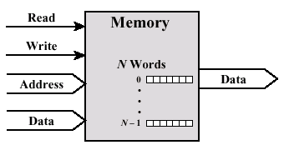
System Buses
Bus Overview
Memory
  Consists of N words of equal length (16, 32, 64, 128 bits)
  Each word is given an unique address which can be read from or written to
  Read/write control signals indicate operation

Slide 50
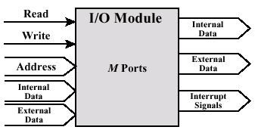
System Buses
Bus Overview
I/O module
  Supports read and write operations
  Controls one or more external devices or ports
  Each port is individually addressable
  There exists internal and external data paths
  I/O can interrupt the processor

Slide 51
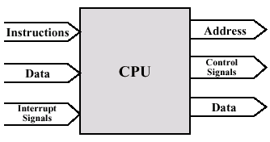
System Buses
Bus Overview
CPU
  Reads in data and instructions
  Writes out data after processing
  Sends control signals to control the overall operation
  Receives interrupt signals

Slide 52

System Buses
Bus Overview
Bus interconnection scheme

Slide 53
System Buses
Bus Overview
Data bus
  Carries data
    Remember that there is no difference between “data” and “instruction” at this level
  Width is a key determinant of performance
    8, 16, 32, 64 bit

Slide 54
System Buses
Bus Overview
Address bus
  Identify the source or destination of data
    e.g. CPU needs to read an instruction (data) from a given location in memory
  Bus width determines maximum memory capacity of system
    e.g. 8080 has 16 bit address bus giving 64k address space
    Capacity depends on what exactly an addresses references: byte, word, sector, etc.

Slide 55
System Buses
Bus Overview
Control bus
  Control and timing information
    Memory read/write signal
    Interrupt request
    Clock signals

Slide 56
System Buses
Bus Overview
Lots of devices on one bus leads to:
  Propagation delays
    Long data paths mean that co-ordination of bus use can adversely affect performance
  If aggregate data transfer approaches bus capacity
Most systems use multiple buses to overcome these problems

Slide 57

System Buses
Bus Overview
Traditional bus architecture

Slide 58
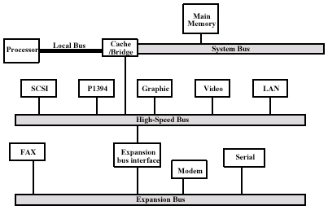
System Buses
Bus Overview
High performance bus

Slide 59
System Buses
Bus Design
Dedicated bus
  Separate data & address lines
Multiplexed bus
  Shared lines
  Address valid or data valid control line
  Advantage - fewer lines
  Disadvantages
    More complex control
    Ultimate performance

Slide 60
System Buses
Bus Design
Arbitration
  More than one module controlling the bus
    e.g. CPU and DMA controller
  Only one module may control bus at one time
  Arbitration may be centralised or distributed

Slide 61
System Buses
Bus Design
Centralized
  Single hardware device controlling bus access
    Bus Controller
    Arbiter
  May be part of CPU or separate
Distributed
  Each module may claim the bus
  Control logic on all modules

Slide 62
System Buses
Bus Design
Timing
  Co-ordination of events on bus
Synchronous
  Events determined by clock signals
  Control Bus includes clock line
  A single 1-0 is a bus cycle
  All devices can read clock line
  Usually sync on leading edge
  Usually a single cycle for an event

Slide 63
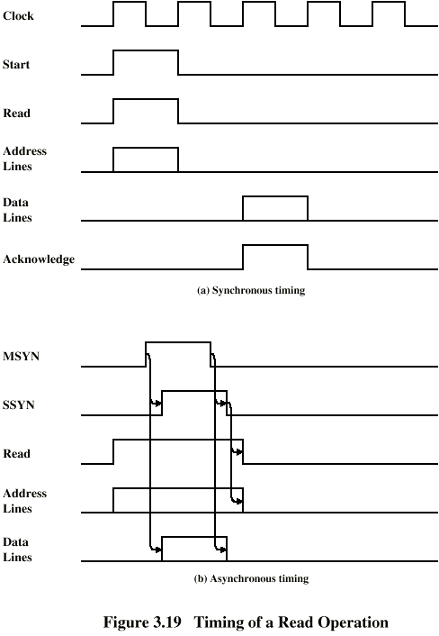
System Buses
Bus Design
Synchronous bus

Slide 64
System Buses
Bus Design
Asynchronous bus

Slide 65
System Buses
Bus Design
Width
  Number of address and data lines
Data transfer type
  Types of operations supported
  Write, read, read-modify-write, read-after-write, block data transfers
address
w data
address
access
time
r data
address
access
time
r data
w data
address
w data
access
time
r data
address
data
data
data

Slide 66
System Buses
Bus Design
address
w data
address
access
time
r data
address
access
time
r data
w data
address
w data
access
time
r data
address
data
data
data
data

Slide 67
System Buses
PCI Bus
Peripheral component interconnect
High-bandwidth, processor independent bus design primarily for PCs
Supports 33 and 66 MHz speeds and 32 or 64 data lines
  What are the data rates for the possible bus configurations?
  PCI-X is an extension of PCI
Main I/O bus architecture in use today

Slide 68
System Buses
PCI Bus
Systems lines
  Including clock and reset
Address & Data
  32 time multiplexed lines for address/data
  Interpret & validate lines
Interface Control
Arbitration
  Not shared
  Direct connection to PCI bus arbiter
Error lines
Mandatory PCI lines

Slide 69
System Buses
PCI Bus
Interrupt lines
  Not shared
Cache support
64-bit Bus Extension
  Additional 32 lines
  Time multiplexed
  2 lines to enable devices to agree to use 64-bit transfer
JTAG/Boundary Scan
  For testing procedures
Optional PCI lines

Slide 70
System Buses
PCI Bus
Transaction between initiator (master) and target
Master claims bus
Determine type of transaction
  e.g. I/O read/write
Address phase
One or more data phases

Slide 71
System Buses
PCI Bus
Commands
  I/O read, I/O write
  Memory read, memory read line, memory read multiple
    Reading 1-4 bytes, a cache line, or more than one cache line
    Indicates to target device to prefetch data
  Memory write, memory write and invalidate
    Writing 1-4 bytes or cache line which should be invalidated
  Configuration read/write

Slide 72
System Buses
PCI Bus
Major signal lines
  CLK – clock
  AD[31::0] – multiplexed address and data lines
  C/BE[3::0] – multiplexed bus command and byte enable lines
  FRAME# - used by bus master to signal a bus transaction
  IRDY# - initiator (i.e. bus master) ready for the transfer
  TRDY# - target ready for data transfer
  DEVSEL# - asserted by target when it recognizes its address
  REQ#, GNT# - request and grant bus access
# - indicates signal is active when 0

Slide 73
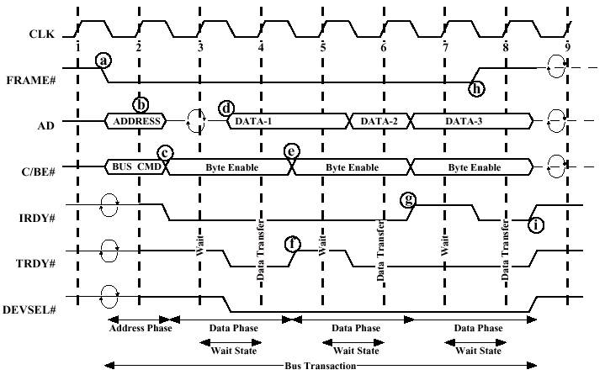
System Buses
PCI Bus

Slide 74
System Buses
PCI Bus
Time 1
  Signal the start of a new transaction (FRAME)
  Place the target address on the bus along with the requested command (e.g. read)
Time 2
  Targets receive the address and must decode it to determine if it’s theirs

Slide 75
System Buses
PCI Bus
Time 3
  Target indicates that it’s there (DEVSEL) and ready for the data transfer (TRDY)
  Initiator starts the data transfer, using the C/BE lines to indicate which bytes contain valid data
Time 4
  Target cannot handle any more data and needs to stall the initiator, so it turns off TRDY

Slide 76
System Buses
PCI Bus
Time 5
  Target is ready to transfer more data
  Initiator transfers the next 4 bytes of data
Time 6
  Initiator now needs to stall the data transfer for some reason, so turns off IRDY
Time 7
  Target and initiator are now both ready again and transfer the last 4 bytes
  The initiator turns off FRAME to signal the end of the transaction

Slide 77
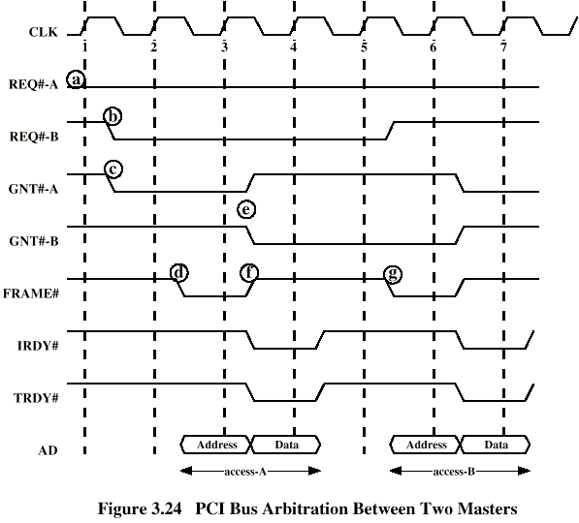
System Buses
PCI Bus

Slide 78
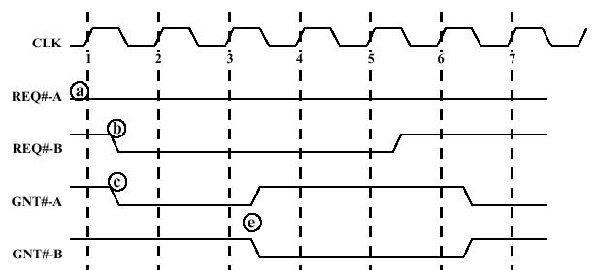
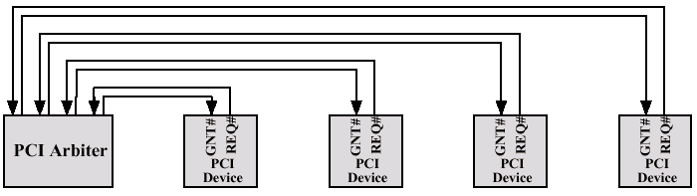
System Buses
PCI Bus
Arbitration

Slide 79
Internal Memory
Overview
Memory provides permanent or temporary storage of instructions and data
A system’s memory requirements vary greatly, thus requiring different memory elements to fulfill all memory needs
Needs are fulfilled by using a memory hierarchy
  Each layer in the hierarchy has different properties

Slide 80
Internal Memory
Overview
Key characteristics
  Location
    CPU, internal (main), external (secondary)
  Capacity
    Word size, number of words
  Access method
    Sequential (tape), direct (disk), random (main memory), associative (cache)

Slide 81
Internal Memory
Overview
Key characteristics
  Performance
    Access time – time to read/write to memory
    Memory cycle time – time to perform one memory access before another one can be performed (e.g. access time + refresh)
    Transfer rate
  Physical characteristics
    Volatile/nonvolatile
    Erasable/nonerasable

Slide 82
Internal Memory
Hierarchy
System design constraints are summed up as:
  How much memory?
  How fast is it?
  How much does it cost?
Unfortunately, there is a trade-off between how fast and how much
  Smaller access time, greater cost per bit
  Greater capacity, smaller cost per bit
  Greater capacity, greater access time

Slide 83
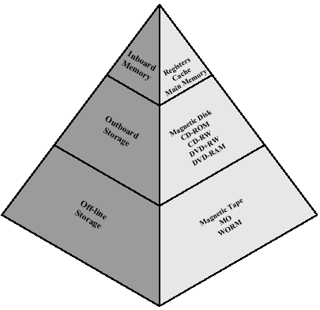
Internal Memory
Hierarchy
Use layers of memory to solve the issue
Moving down the hierarchy
  Decrease cost/bit
  Increase capacity
  Increase access time
  Decrease frequency of use

Slide 84
Internal Memory
Hierarchy
Locality of reference
  Spatial – items physically close together tend to be accessed together
  Temporal – recently accessed items are likely to be accessed again in the near future
  E.g. about 10% of a program’s instructions account for 90% of its processing time
  E.g. access related data records, reading sequentially from a file
Question then becomes a matter of properly selecting which data to store in higher layers

Slide 85
Internal Memory
Semiconductor Memory - RAM
Volatile
Supports reads and writes
Two main technologies
  Static – uses flip-flops to store values, state is maintained as long as power is supplied
    Generally faster
  Dynamic – stores data in capacitors and must be recharged periodically
    Simpler, denser, and less expensive

Slide 86
Internal Memory
Semiconductor Memory - RAM
DRAM (Dynamic RAM)
SRAM (Static RAM)
EDRAM (Enhanced DRAM)
  Uses a small amount of SRAM as a cache to lower average access times
CDRAM (Cache DRAM)
  Uses a larger amount of SRAM
SDRAM (Synchronized DRAM)
  Synchronized with the processor clock speed to eliminate wait states

Slide 87
Internal Memory
Semiconductor Memory - RAM
CMOS RAM
  Complimentary metal oxide silicon RAM
  Low power consumption RAM
  Stores basic information such as time
RDRAM (Rambus DRAM)
  Uses more accurate clocking and better signals
  Provides better performance
DDR SRAM (Double data rate)
  Doubles potential bandwidth

Slide 88
Internal Memory
Semiconductor Memory - ROM
Memory type | Category | Erasure | Write
ROM | Read-only | None | Masks
Programmable ROM |  |  | Electrically
Erasable PROM | Read-mostly | UV light, chip level
Flash |  | Electrical, block level
Electrically EPROM |  | Electrically, byte level
Costs increase down table

Slide 89
Internal Memory
Design
Memory cells store a single bit of information
Can be implemented as a flip-flop, latch, etc.
Control signal determines read/write
Select line activates operation
control
cell
data
select

Slide 90
Internal Memory
Design
00 01 10 11
00
01
10
11
cell
cell
cell
cell
We can think of a collection of memory cells graphically
  Place into a matrix
Matrices stacked on each other allow multiple bits to be read at the same time
  R/W words
Addresses are (row, column) pairs
cell
cell
cell
cell
address
1001
cell
cell
cell
cell
cell
cell
cell
cell
4x4 bit memory (16 bits total)
cell
cell
cell
cell
cell
cell
cell
cell
cell
cell
cell
cell
cell
cell
cell
cell
cell
cell
cell
cell
cell
cell
cell
cell
cell
cell
cell
cell
cell
cell
cell
cell
4x4x2 bit memory (32 bits total)
R/W 2 bits at a time

Slide 91
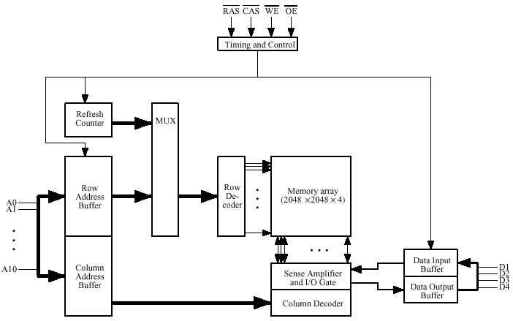
Internal Memory
Design
Control signals
Row address select
Column address select
Write enabled
Output enabled
Need to refresh memory values occasionally
R/W 4-bits at a time
Buffer R/W data
until ready
Multiplexed address lines
requires 2 cycles

Slide 92
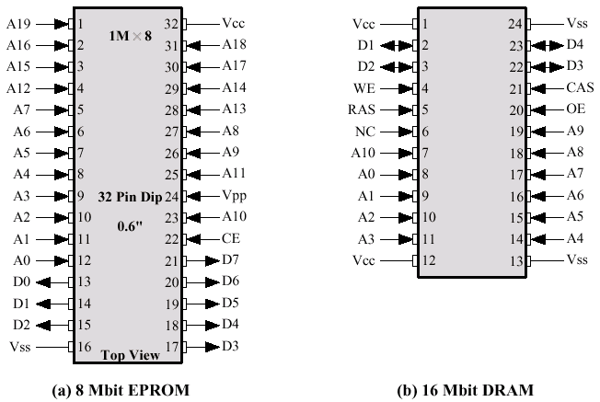
Internal Memory
Design
Chip enable (select line)

Slide 93
Internal Memory
Errors
Error correction
  Hard failure – memory cell is stuck at a specific value
  Soft failure – random event that changes the memory value
Store data + additional bits of data necessary for detecting or correcting errors (code bits)

Slide 94
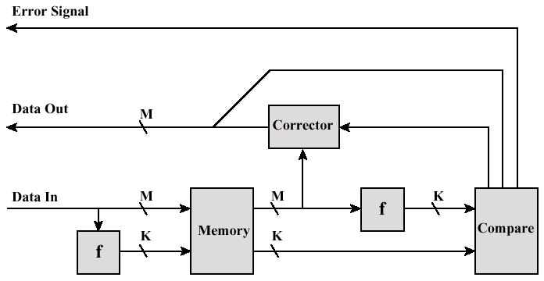
Internal Memory
Errors
Correct any errors
or signal error
Desired data bits
Error code bits

Slide 95
Internal Memory
Errors
Data = 1110
Sum is even
1
1
0
1
1
0
Corrects single
bit errors
0
Code = 1110100
Hamming Codes can be used to correct bit errors

Slide 96
Cache
Overview
Main memory is too slow to keep up with processor speeds
Would like a reasonable sized memory able to deliver data to the processor’s registers at speeds close to the processor’s core speed
A cache provides a copy of some of the contents of main memory

Slide 97
Cache
Overview
Caches rely on locality of reference
When a word is read from main memory, a block is read into the cache
Words next to the one fetched are then provided by the cache, improving overall performance
CPU
word
Cache
block
Memory

Slide 98
Cache
Overview
block
CPU
desired word
0
1
0
2
1
3
4
K
5
Cache
N-2
N-1
Memory

Slide 99
Cache
Overview
Cache sizes must be large enough to approach main memory costs per bit
Must be small enough for the average access time to be close to the CPU registers
Smaller cache sizes operate faster, but want to avoid too many fetches from memory
Optimal cache sizes range from 1K to 512K
  Second level caches can be larger, up to a few megabytes

Slide 100
Cache
Overview
There are fewer cache slots than total memory blocks
  E.g. main memory is up to 4 GB, but cache sizes are 512 KB
Multiple blocks from memory must share the same cache slot
Need an algorithm to determine which slot a block from memory occupies
  Replacement algorithm determines which block in cache is removed

Slide 101
Cache
Mapping
data
address
word (byte)
0
0000
block
0
1
1
0001
00
2
0010
01
3
0011
10
4
0100
11
5
0101
Cache
E
1110
F
1111
Cache holds 8 words – 4 blocks
Memory contains 16 words – 8 blocks
Word size is 1 byte
Memory

Slide 102
Cache
Direct-Mapped
Each block of main memory maps into a single cache slot
slot number = block number mod cache lines
Mapping is easily done using the address
  Tag is needed to determine if desired word is the one currently cached
tag
slot
word
address

Slide 103
Cache
Direct-Mapped
address
word (byte)
0
0000
block
tag
0
1
1
0001
0
0
1
00
2
0010
1
A
B
01
3
0011
0
4
5
10
4
0100
1
E
F
11
5
0101
Cache
E
1110
0 10 1
F
1111
tag
word
Memory
slot

Slide 104
Cache
Direct-Mapped
No two blocks mapped into the same slot or cache line have the same tag
Simple and inexpensive to implement
Only one cache location for any given block
  Can lead to two blocks swapping each other out of cache
  Lowers cache hit rate

Slide 105
Cache
Direct-Mapped
Examples
  Using the previous example, which cache line will address 1100 be mapped into?
  Assuming that the cache is empty to start, a program accesses memory locations 0001, 0010, 0011, 1010, 0010, 1100, 0010, 0011, 1010, and 1000. What percent of the memory accesses are provided by the cache?
  How many memory references are needed in the above example?
  Reorder the accesses to decrease memory accesses.

Slide 106
Cache
Associative
Permits any memory block to be loaded into any cache line
Increases the cache hit count
All tags must be checked in parallel to determine if a given memory address is cached
  Leads to expensive and complex circuitry
tag
word
address

Slide 107
Cache
Associative
address
word (byte)
0
0000
block
tag
0
1
1
0001
111
E
F
00
2
0010
000
0
1
01
3
0011
010
4
5
10
4
0100
101
A
B
11
5
0101
Cache
E
1110
010 1
F
1111
tag
word
Memory

Slide 108
Cache
Associative
Need to determine which block to replace when bringing in a new block
Trade-off between algorithm complexity and hit ratio
Least recently used (LRU)
  Most effective
  Replace block in cache the longest without any references to it
  Can implement using a reference counter

Slide 109
Cache
Associative
First in first out (FIFO)
  Replace the block that has been in the cache the longest
  Ignores reference
  Easily implemented using circular buffer
    Requires a single counter to store the next cache line to use

Slide 110
Cache
Associative
Least frequently used (LFU)
  Replace block with fewest number of references
  Requires hit counter for each cache line
Random
  Just pick one
  Only slightly inferior performance compared to algorithms based on usage

Slide 111
Cache
Associative
Examples
  Perform the following for each of the 4 replacement algorithms.
    Random #s: 0,1,3,1,2,0,0,2,3,2,3,0,1,0,3,3,1,0,3,2
  Assuming that the cache is empty to start, a program accesses memory locations 0001, 0010, 0011, 1010, 0010, 1100, 0010, 0011, 1010, and 1000. What percent of the memory accesses are provided by the cache?
  How many memory references are needed in the above example?
  Reorder the accesses to decrease memory accesses.

Slide 112
Cache
Set Associative
Combines direct and associative mapping
Gives advantages of both without their main disadvantages
Divide cache lines into sets
  The number of lines per set is expressed as n-way, e.g. 2-way, 4-way, etc.
Use direct mapping into a set, and associative mapping within a set
tag
set
word
address

Slide 113
Cache
Set Associative
address
word (byte)
0
0000
block
tag
0
1
1
0001
10
8
9
2
0010
0
00
0
1
3
0011
01
2
3
4
0100
1
11
E
F
5
0101
Cache
mod 2
E
1110
01 0 1
F
1111
tag
word
Memory
set

Slide 114
Cache
Set Associative
If there is only one set, mapping is fully associative
If a set contains only one cache line, mapping is direct
2-way and 4-way set associative are most common
  2-way is easy to implement LRU
  4-way is only slightly harder, but gives a modest performance gain
  Greater associativity has little effect

Slide 115
Cache
Set Associative
Examples
  Assume a LRU algorithm with 2-way associativity
  Assuming that the cache is empty to start, a program accesses memory locations 0001, 0010, 0011, 1010, 0010, 1100, 0010, 0011, 1010, and 1000. What percent of the memory accesses are provided by the cache?
  How many memory references are needed in the above example?
  Reorder the accesses to decrease memory accesses.

Slide 116
Cache
Write Policy
Writes from the processor affect the caching policy
Cannot replace a cache line if it has been written to without writing its contents out to memory first
Need to maintain cache coherency
  All modules of system have the same view of memory
  E.g. writes by CPU to cache must be seen by I/O modules reading memory

Slide 117
Cache
Write Policy
Write-through policy
  Writes to the cache are written “through” to main memory as well
  Slows down writes to the speed of memory
  May create a memory bottleneck performing writes
    Even if data is not accessed by other modules
  About 15% of all memory accesses are writes

Slide 118
Cache
Write Policy
Write-back policy
  Updates are only written (back) to the cache when replaced
  A dirty bit indicates when a cache line has been updated
  Updated cache lines are written to memory when being replaced
  Provides faster writes, but is more difficult to maintain coherency with other units

Slide 119
Cache
Write Policy
Coherency
  Need to maintain consistent view of memory between different CPU caches and memory
  Bus snooping
    Use write-through caching
    Processors listen on the bus for addresses that they have cached
    If a match is detected, the entry is invalidated

Slide 120
Cache
Write Policy
Coherency
  Hardware transparency
    Additional hardware updates main memory and all caches with any updates
  Non-cachable memory
    Only read-only or private memory may be cached
    Accesses to shared memory that can be written to by multiple units always result in cache misses

Slide 121
Cache
Write Policy
What if the processor tries to write to memory that is not already cached?
Can write through to memory directly
Can load into cache, then perform write
  Write-through or write-back
Typically write-through goes directly to memory without loading it into cache
Write-back loads into cache, then performs write

Slide 122
Cache
Write Policy
Examples
  Assume a LRU algorithm with 2-way associativity
  Perform for write-back and write-through
  Accesses: R, W, R, R, R, W, R, W, W, R
  Assuming that the cache is empty to start, a program accesses memory locations 0001, 0010, 0011, 1000, 0010, 1100, 0100, 0101, 0000, and 1000. What percent of the memory accesses are provided by the cache?
  How many memory references are needed in the above example?
  Reorder the accesses to decrease memory accesses.

Slide 123
Cache
Organization
Block sizes
  Need to determine optimal block size to load into memory
  Small blocks result in memory accesses
  Larger blocks reduce the number of blocks that fit into the cache – blocks are overwritten sooner
  With larger blocks, additional words are farther from the requested word and are less likely to be needed
  Block sizes of 4 to 8 addressable units seem optimal

Slide 124
Cache
Organization
One versus two caches
  Can provide a second level cache that operates slightly slower than the L1 cache
  Cache is several times larger than L1 cache
  In general, an L2 cache improves performance but increases cost
  Hit rates average 80-90% for L1 and around 60% for L2
    I.e. the L2 cache contains about 95% of all requested data, but many accesses are fulfilled by L1 cache

Slide 125
Cache
Organization
Unified versus dedicated caches
  Cache can store both instructions and data or two caches can be used
  Use of two caches eliminates contention for the cache between the instruction processor (PC and IR) and execution units (ALU)
    Allows execution of multiple instructions at the same time
  Used by most PC processors

Slide 126
External Storage

Slide 127
External Storage
Overview
Magnetic Disk
  RAID
  Removable
Optical
  CD-ROM
  CD-Writable (WORM)
  CD-R/W
  DVD
Magnetic Tape

Slide 128
Magnetic Disks
Organization
Disk is constructed using magnetizable material (iron oxide - rust)
Magnetic patterns are recorded onto the surface and read back
A disk head reads and writes data onto the disk
  Reads/writes blocks of data
Range of packaging
  Floppy
  Winchester hard disk
  Removable hard disk

Slide 129
Magnetic Disks
Organization
Concentric rings or tracks
  Gaps between tracks
  Reduce gap to increase capacity
  Same number of bits per track (variable packing density)
  Constant angular velocity (rotation speed)
Tracks divided into sectors
Minimum block size is one sector
May have more than one sector per block

Slide 130
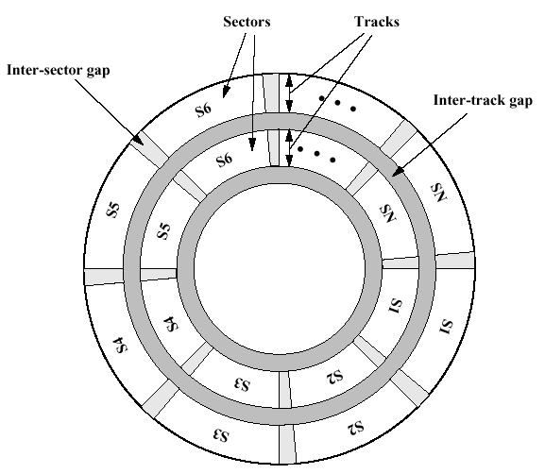
Magnetic Disks
Organization

Slide 131
Magnetic Disks
Characteristics
Fixed (rare) or movable head
Removable or fixed
Single or double (usually) sided
Single or multiple platter
Head mechanism
  Contact (Floppy)
  Fixed gap
  Flying (Winchester)

Slide 132
Magnetic Disks
Characteristics
Fixed head
  One read write head per track
  Heads mounted on fixed ridged arm
Movable head
  One read write head per side
  Mounted on a movable arm
Removable disk
  Can be removed from drive and replaced with another disk
  Provides unlimited storage capacity
  Easy data transfer between systems
Nonremovable disk
  Permanently mounted in the drive

Slide 133
Magnetic Disks
Characteristics
Double sided
  One R/W head per side
  Heads are joined and aligned
    Move together
  Aligned tracks on each platter form cylinders
  Data is striped by cylinder
    Reduces head movement
    Increases transfer rate

Slide 134
Magnetic Disks
Characteristics
Format
  Identifies start of tracks and sectors
  Stores additional information to mark tracks and sectors
Gap1
Id
Gap2
Data
Gap3
Gap1
Id
Gap2
Data
Gap3
Sync
byte
Track
Head
Sector
CRC
Sync
byte
Data
CRC

Slide 135
Magnetic Disks
Characteristics
Seek time
  Moving head to correct track
(Rotational) latency
  Waiting for data to rotate under head
  An average of one-half spin
Access time =
seek time + rotational latency
Transfer rate
  Peak amount of data transferred to/from disk
  Typically ~10 MBps

Slide 136
Magnetic Disks
Examples
Floppy
  5.25”, 3.5”
  Small capacity
    Up to 1.44Mbyte (2.88M never popular)
  Slow
  Universal
  Cheap
ZIP
  Cheap
  Very common
  Only 100M

Slide 137
Magnetic Disks
Examples
Winchester hard disk
  Sealed unit
  One or more platters (disks)
  Heads fly on layer of air as disk spins
    Very small head to disk gap
  Universal
  Cheap
  Fastest external storage
  Large data storage – several gigabytes
    72 GB currently available

Slide 138
RAID
Overview
Redundant Array of Independent/Inexpensive Disks
6 levels in common use
  Not a hierarchy
Set of physical disks viewed as single logical drive by O/S
Data distributed across physical drives
Can use redundant capacity to store parity information

Slide 139
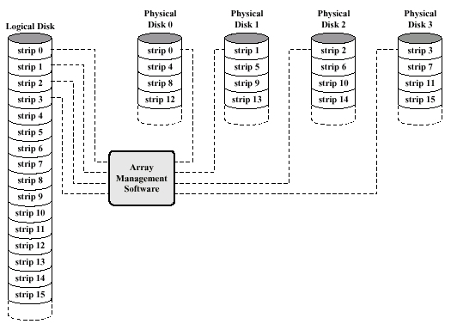
RAID
Overview

Slide 140
RAID
Level 0 (Striping)
No redundancy
Data striped across all disks
Round-robin striping
Increases speed
  Multiple data requests probably not on same disk
  Disks seek in parallel
  A set of data is likely to be striped across multiple disks
Good for high-performance access

Slide 141
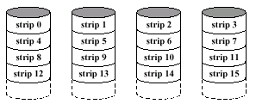
RAID
Level 0 (Striping)

Slide 142
RAID
Level 1 (Mirroring)
Mirrored Disks
Data is striped across disks
2 copies of each stripe on separate disks
Read from either
Write to both
Recovery is simple
  Swap faulty disk & re-mirror
  No down time
Expensive
Good for operating system disk

Slide 143
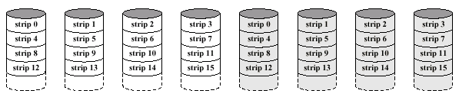
RAID
Level 1 (Mirroring)

Slide 144
RAID
Level 3
Very small strips
A single redundant disk
  Simple parity bit for each set of corresponding bits
Data on failed drive can be reconstructed from surviving data and parity info
Very high transfer rates but poor request rate
Good for video, CAD, and imaging systems
  Large, sequential reads

Slide 145
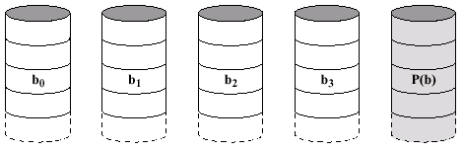
RAID
Level 3

Slide 146
RAID
Level 5
Each disk operates independently
  Good for high I/O request rate
Large stripes
Parity striped across all disks
  Round robin allocation for parity stripe
Good for network servers (file servers, e-mail, web, etc. )
Does not mean 5 disks

Slide 147
CD-ROM
Overview
Originally for audio
650 MB
  ~70 minutes audio
Polycarbonate coated with highly reflective coat, usually aluminum
Data stored as pits
  Read by reflecting laser
Constant packing density
  Constant linear velocity

Slide 148
CD-ROM
Overview
Audio is single speed
  Constant linier velocity
  1.2 ms⁻¹
  Track (spiral) is 5.27km long
  Gives 4391 seconds = 73.2 minutes
Other speeds are quoted as multiples
  E.g. 8x, 24x, 40x

Slide 149
CD-ROM
Overview
00
FF
x 10
00
Layered
ECC
Sec
Mode
Data
Min
Sector
12 byte
Sync
4 byte
Id
2048 byte
288 byte
2352 byte
Mode 0=blank data field
Mode 1=2048 byte data+error correction
Mode 2=2336 byte data

Slide 150
CD-ROM
Overview
Random-access is difficult due to variable speed
  Move head to rough position
  Set correct speed
  Read address
  Adjust to required location
Slow
Read only
Easy to mass produce
  Expensive for small runs
Removable
Robust

Slide 151
CD-ROM
Writable CDs
CD-Writable
  WORM
  Now affordable
  Compatible with CD-ROM drives
CD-RW
  Erasable
  Getting cheaper
  Mostly CD-ROM drive compatible

Slide 152
DVD
Overview
Digital Video Disk
  Used to indicate a player for movies
  Only plays video disks
Digital Versatile Disk
  Used to indicate a computer drive
  Will read computer disks and play video disks
DVD drives cannot automatically decode and play movies

Slide 153
DVD
Overview
Multi-layer
Very high capacity (4.7G per layer)
Full length movie on single disk
  Using MPEG compression
Standardized
Movies carry regional coding
  Players only play correct region films

Slide 154
Magnetic Tapes
Overview
Serial access
Slow
Very cheap
Mainly backup and archive
Digital Audio Tape (DAT)
  Uses rotating head (like video)
  High capacity on small tape
    4Gbyte uncompressed
    8Gbyte compressed
  Backup of PC/network servers

Slide 155
Input/Output
Overview
Need to bring data into the system and save results
Device types
  Human readable
    Screen, printer, keyboard
  Machine readable
    Disks, tapes, sensors
  Communication (remote device)
    Modem, Network Interface Card (NIC)

Slide 156
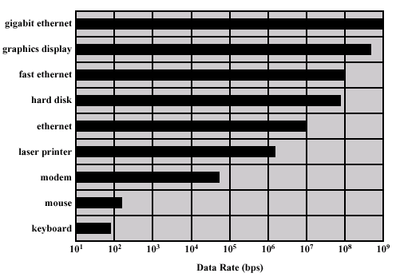
Input/Output
Overview

Slide 157
Input/Output
Overview
Wide variety of peripherals
  Deliver different amounts of data
  At different speeds
  In different formats
All slower than CPU and RAM
Need I/O modules to connect peripherals to the system bus

Slide 158
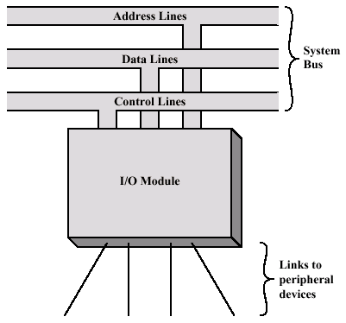
Input/Output
I/O Module

Slide 159
Input/Output
I/O Module Function
Control & timing
  Coordinate traffic flow between internal and external devices
CPU communication
  Process CPU requests
Device communication
  Read/write data to device
Data buffering
Error detection

Slide 160
Input/Output
Example Operation
CPU checks I/O module device status
I/O module returns status
If ready, CPU requests data transfer
I/O module gets data from device
I/O module transfers data to CPU
Variations for output, DMA, etc.

Slide 161
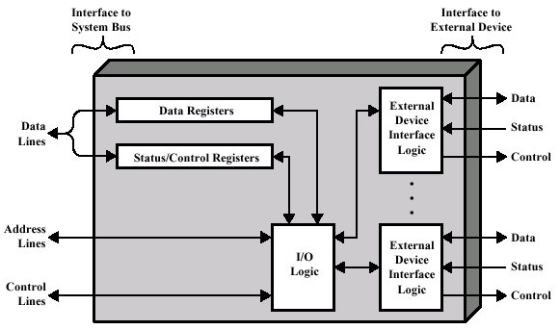
Input/Output
I/O Module

Slide 162
Input/Output
I/O Module
Support multiple or single device
Hide or reveal device properties to CPU
  Control device functions or leave for CPU
I/O Techniques
  Programmed I/O
  Interrupt driven I/O
  Direct Memory Access (DMA)

Slide 163
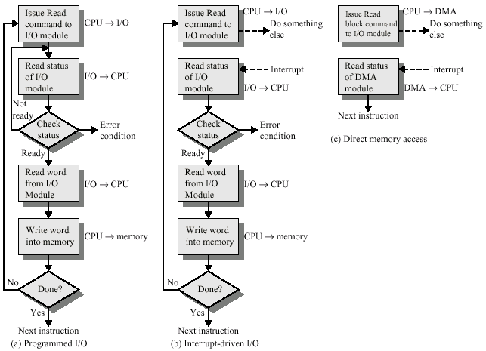
Input/Output
I/O Module

Slide 164
Input/Output
Programmed I/O
CPU has direct control over I/O
  Sensing status
  Read/write commands
  Transferring data
CPU waits for I/O module to complete operation
Wastes CPU time

Slide 165
Input/Output
Programmed I/O
CPU issues address
  Identifies module and device
  Similar to accessing memory from CPU viewpoint
CPU issues command
  Control - telling module what to do
    E.g. Spin up disk
  Test - check status
    E.g. Power? Error? Done?
  Read/Write
    Module transfers data via buffer from/to device

Slide 166
Input/Output
Programmed I/O
CPU requests I/O operation
I/O module performs operation
I/O module sets status bits
CPU checks status bits periodically
I/O module does not inform CPU directly
I/O module does not interrupt CPU
CPU may wait or come back later

Slide 167
Input/Output
I/O Mapping
CPU accesses I/O one of two ways:
Isolated I/O
  Separate address spaces for I/O devices
  Need I/O or memory select lines
  Special commands for I/O
Memory mapped I/O
  Devices and memory share an address space
  I/O looks just like memory read/write
  No special commands for I/O

Slide 168
Input/Output
Interrupt Driven I/O
Overcomes CPU waiting
CPU does not repeatedly check device for a completion
I/O module interrupts when ready
  Done or error

Slide 169
Input/Output
Interrupt Driven I/O
CPU issues read command
I/O module gets data from peripheral
  CPU does other work
I/O module interrupts CPU
CPU requests data
I/O module transfers data

Slide 170
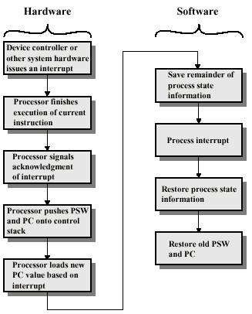
Input/Output
Interrupt Driven I/O
Check for interrupts after instruction
Save Program Status Word (PSW) – current processor state
Return to regular scheduled program

Slide 171
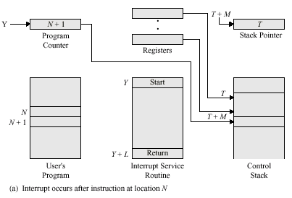
Input/Output
Interrupt Driven I/O

Slide 172
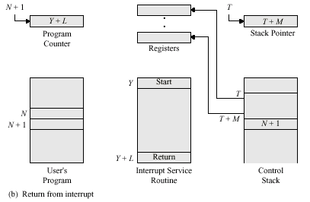
Input/Output
Interrupt Driven I/O

Slide 173
Input/Output
Interrupt Driven I/O
When an interrupt occurs, need to identify device causing interrupt
Multiple interrupt lines
  Limits number of devices
Software poll
  CPU asks devices in turn
  Slow

Slide 174
Input/Output
Interrupt Driven I/O
Hardware poll – daisy chain, vectored
  Interrupt acknowledge sent down a chain
  Module responsible places vector on bus
  CPU uses vector to identify handler routine
Bus arbitration – vectored
  Module must claim the bus before it can raise interrupt
  E.g. PCI & SCSI

Slide 175
Input/Output
Interrupt Driven I/O
Multiple devices can interrupt at the same time
Each interrupt line has a priority
Higher priority lines can interrupt lower priority lines
If bus mastering only current master can interrupt

Slide 176
Input/Output
DMA
Interrupt driven and programmed I/O require active CPU intervention
  Transfer rate is limited
  CPU is tied up
DMA removes CPU involvement
Additional hardware required on bus
  DMA controller
DMA controller takes over from CPU for I/O

Slide 177
Input/Output
DMA
CPU tells DMA controller
  Read/Write
  Device address
  Starting address of memory block for data
  Amount of data to be transferred
CPU carries on with other work
DMA controller completes transfer
DMA controller interrupts CPU when finished

Slide 178
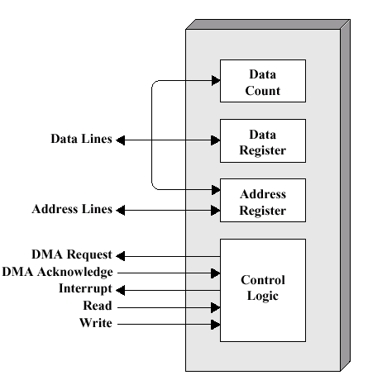
Input/Output
DMA

Slide 179
Input/Output
DMA
Cycle Stealing
  DMA controller takes over system bus for one cycle
  Transfers one word of data
  Not an interrupt
    CPU does not switch context
  CPU suspended just before it accesses bus
    I.e. before an operand or data fetch or a data write
  Slows down CPU but not as much as CPU doing transfer
  If data is cached, CPU is not stalled

Slide 180
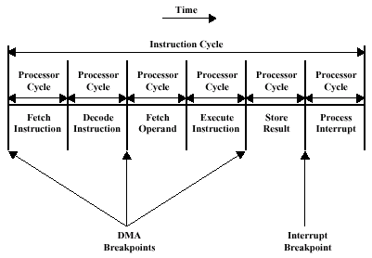
Input/Output
DMA

Slide 181
Input/Output
I/O Channels
Future of I/O interconnects
I/O devices are more sophisticated and intelligent
  E.g. 3D graphics cards
CPU instructs I/O controller to do transfer
I/O controller does entire transfer
  Takes load off CPU
  Dedicated processor is faster

Slide 182
SCSI
Overview
Small Computer System Interface
Interface for external peripheral devices
  Disk drives, CD-ROM, tape devices
Parallel interface
8, 16, or 32 bit data lines
5, 10 (fast), 20 (ultra), 40 (ultra-2) MHz
Daisy chained “bus”
Devices are independent
  Can communicate with each other as well as controller

Slide 183
SCSI
Overview
SCSI-1
  Early 1980s
  8 bit
  5 MHz
  Data rate 5 MBps
  Eight devices
    Controller + 7 others
SCSI-2 (Fast)
  1991
  16 and 32 bit
  10MHz
  Data rate 20 or 40 Mbytes
SCSI-3 (Ultra)
  Up to 80 MBps
SCSI-4 (Ultra-2)
  Up to 160 MBps

Slide 184
SCSI
Operation
Between initiator and target
  Usually controller & device (e.g. disk)
Activity on the bus occurs in a sequence of phases
  Bus free
  Arbitration
    Take control of bus
  Selection of target

Slide 185
SCSI
Operation
Phases continued
  Reselection by target to initiator
    Allows reconnection after suspension to resume an operation
    E.g. if request takes time to execute, bus can be released
  Command
    Target requests command information from the initiator
  Data
    Target requests data in or out of the initiator
  Status request
  Message request
    E.g message complete

Slide 186
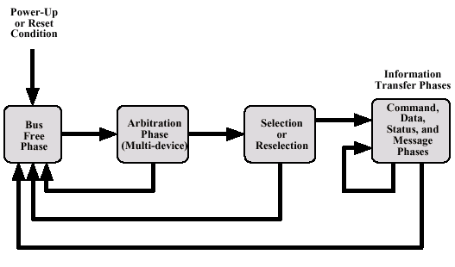
SCSI
Operation

Slide 187
Operating System Support
Overview
An operating system is a program that controls the execution of application programs
Acts as an interface between the user and the HW
Provides two main functions
  Convenience
    Makes the computer more convenient to use
  Efficiency
    Allows system resources to be used efficiently

Slide 188
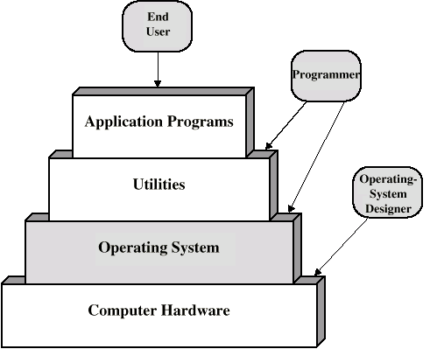
Operating System Support
Overview

Slide 189
Operating System Support
Overview
Operating systems usually provide services in several main areas:
  Program creation
    Assists programmer with utilities
  Program execution
    A number of tasks must be performed to begin program execution
    E.g. loading instructions and data, initializing I/O devices, file management, etc.

Slide 190
Operating System Support
Overview
Operating systems services continued
  Access to I/O devices
    Exposes simple read/write interface
    Hides control signals and device specific instructions
  Controlled access to files
    Format of files on underlying media
    Provide control for multiple users accessing shared files

Slide 191
Operating System Support
Overview
Operating systems services continued
  Error detection and response
    Interrupt handling, protection errors
  Accounting
    Time usage on CPU or devices

Slide 192
Operating System Support
Resource Management
A computer is a set of resources for the movement, storage, and processing of data
The operating system is responsible for managing these resources
The OS controls the system resources
  But the OS is just another program
  And the OS must give up the processor to allow other applications to run

Slide 193
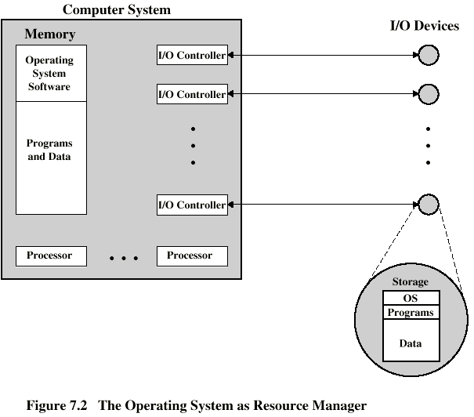
Operating System Support
Resource Management

Slide 194
Operating System Support
Types of Operating Systems
Interactive
Batch
Single program (Uni-programming)
Multiple programs (Multi-tasking)
Contemporary systems are interactive with multi-tasking

Slide 195
Operating System Support
Types of Operating Systems
History
  Late 1940s to mid 1950s
  No operating system
  Programs interact directly with hardware
  Two main problems:
    Scheduling
      Use a sign up sheet to gain access to the system
      Still used today to gain access to limited hardware resources
    Setup time
      A considerable amount of time was spent just getting the system ready for use (punch cards, tapes, etc.)

Slide 196
Operating System Support
Batch Systems
Initial machines were too expensive
Needed to remove setup and lost scheduling time
Resident Monitor program
  Monitor is always in main memory (resident)
  Users submit jobs to operator
  Operator batches jobs
  Monitor controls sequence of events to process batch
  When one job is finished, control returns to monitor which reads next job
  Monitor handles scheduling

Slide 197
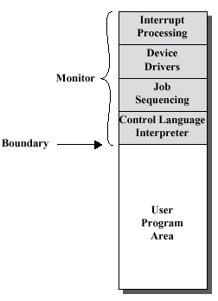
Operating System Support
Batch Systems
Monitor executes its code then “passes control to the job”
  I.e. it sets the PC into the user area
Control is returned to monitor when job finishes
  I.e. PC goes back to monitor memory area

Slide 198
Operating System Support
Batch Systems
Job control language
  Instructions to monitor by user application
  Usually denoted by $
  E.g.
    $JOB
    $FTN
    ... Some Fortran instructions
    $LOAD
    $RUN
    ... Some data
    $END

Slide 199
Operating System Support
Batch Systems
For monitor to work, certain hardware features are highly desired
  Memory protection
    To protect the monitor from application overwriting its memory
  Timer
    To prevent a job monopolizing the system
  Privileged instructions
    Only executed by monitor – application must ask monitor to perform the work on its behalf
    E.g. I/O
  Interrupts
    Allows for relinquishing and regaining control

Slide 200



Operating System Support
Batch Systems
Monitor now consumes part of main memory and processor time
System is used more efficiently by removing idle time due to setup and scheduling

Slide 201
Operating System Support
Multiprogrammed Batch Systems
Assume a program performs one read, executes 100 instructions, then writes the result
  I/O takes 15 ms, and 100 instructions take 1 ms total
  CPU is busy 3% of the time
I/O devices very slow
When one program is waiting for I/O, another can use the CPU
  Memory already stores 2 programs – monitor and user application – why not add another?

Slide 202
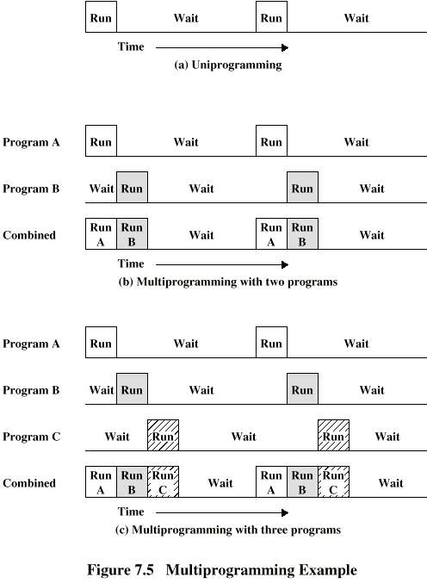
Operating System Support
Multiprogrammed Batch Systems

Slide 203
Operating System Support
Multiprogrammed Batch Systems

Slide 204
Operating System Support
Multiprogrammed Batch Systems
Each job individually takes the same amount of time, but time for all jobs gets done quicker
  E.g. washing second load while first one is in the dryer
Requires that jobs do not compete for the same resources
Also requires memory management to keep multiple jobs in memory at the same time
Scheduling is required to determine which job to run next

Slide 205
Operating System Support
Interactive Systems
Allow users to interact directly with the computer
  I.e. time sharing
Multi-programming allows a number of users to interact with the computer simultaneously

Slide 206
Operating System Support
Scheduling
Scheduling is the key to multi-programming
Three types of scheduling of processes are involved
  Long, medium, and short term
I/O scheduling
A process is a program in execution
  Threads are the active components of a process

Slide 207
Operating System Support
Scheduling
The long term scheduler determines which programs are submitted for processing
  Controls the degree of multi-programming
  How many programs may execute at once
Once submitted, a job becomes a process for the short term scheduler
Or it becomes a swapped out job for the medium term scheduler

Slide 208
Operating System Support
Scheduling
The medium term scheduler is part of the swapping function
  Will be discussed later

Slide 209
Operating System Support
Scheduling
The short term scheduler is known as the dispatcher
  Makes fine-grained decisions of which job to execute next
  I.e. determines which job will use the processor in the next time slot
To understand the dispatcher, we need to consider process states
  The status of the process along with additional information

Slide 210
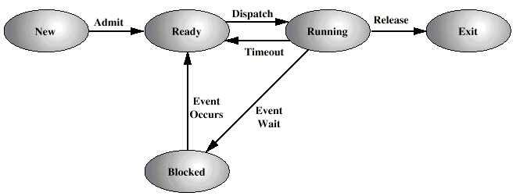
Operating System Support
Scheduling

Slide 211
Operating System Support
Scheduling
Each process is represented by the operating system as a process control block
The process control block typically contains information necessary to start and stop the process’s execution
  Identifier State
  Priority Program counter
  Memory pointers Context data
  I/O status Accounting information

Slide 212
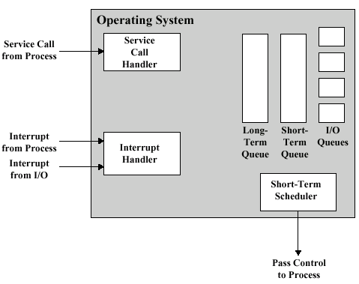
Operating System Support
Scheduling

Slide 213
Operating System Support
Scheduling
Process
Request
Long-Term Q
Short-Term Q
End
CPU
I/O
I/O Queue
I/O
I/O Queue
I/O
I/O Queue

Slide 214
Operating System Support
Memory Management
Memory must be divided into parts
Uni-program
  Memory split into two
    One for operating system (monitor)
    One for currently executing program
Multi-program
  “User” part is sub-divided and shared among active processes
Want to pack user programs into memory efficiently to avoid all processes being stalled

Slide 215
Operating System Support
Memory Management
Problem: I/O is so slow compared with CPU that even in multi-programming system, CPU can be idle most of the time
Solutions:
  Increase main memory
    Expensive
    Leads to larger programs
  Swapping

Slide 216
Operating System Support
Memory Management
Long term queue of processes stored on disk
Processes “swapped” in as space becomes available
As a process completes it is moved out of main memory
If none of the processes in memory are ready (i.e. all I/O blocked)
  Swap out a blocked process to intermediate queue
  Swap in a ready process or a new process
  But swapping is an I/O process...
    Could make things worse

Slide 217
Operating System Support
Memory Management
Partitioning
  Splitting memory into sections to allocate to processes (including Operating System)
  Fixed-sized partitions
    May not be equal size
    Process is fitted into smallest hole that will take it (best fit)
    Some wasted memory
    Leads to variable sized partitions

Slide 218
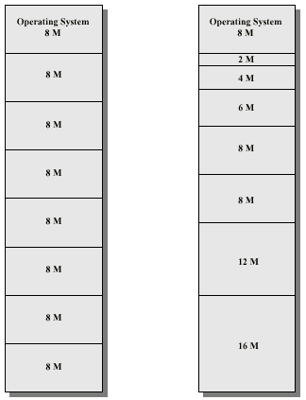
Operating System Support
Memory Management
Variable sized
partitions
Fixed sized
partitions

Slide 219
Operating System Support
Memory Management
Allocate exactly the required memory to a process
This leads to a hole at the end of memory, too small to use
  Only one small hole - less waste
When all processes are blocked, swap out a process and bring in another

Slide 220
Operating System Support
Memory Management
New process may be smaller than swapped out process
  Another hole
Eventually have lots of holes (fragmentation)
Solutions:
  Coalesce - Join adjacent holes into one large hole
  Compaction - From time to time go through memory and move all free memory into one free block
    similar to disk de-fragmentation

Slide 221
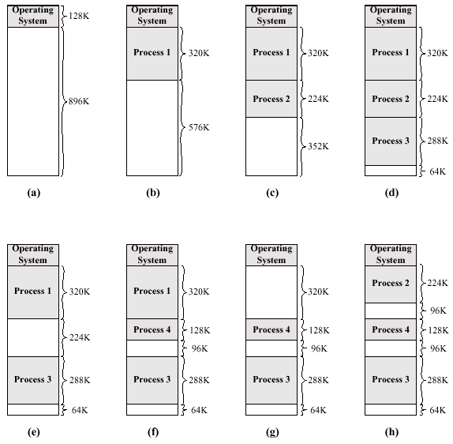
Operating System Support
Memory Management

Slide 222
Operating System Support
Memory Management
Note that in any partitioning case, a process may not be loaded into the same location in memory
But instructions contain memory addresses
  Locations of data
  Addresses for instructions (branching)
We need a new way to address memory…

Slide 223
Operating System Support
Memory Management
Logical addresses
  Relative to beginning of program
  A program only cares about instructions within its own code
  Reference instructions and data based on where it’s located in memory
Translate logical addresses into physical address
  Actual location in memory
  Must fetch data from physical memory
Let OS and HW provide automatic conversion using base address

Slide 224
Operating System Support
Memory Management
Paging
  Split memory into equal sized, small chunks -page frames
  Split programs (processes) into equal sized small chunks - pages
  Allocate the required number page frames to a process
  Operating system maintains list of free frames
  A process does not require contiguous page frames
  Use page table to keep track

Slide 225
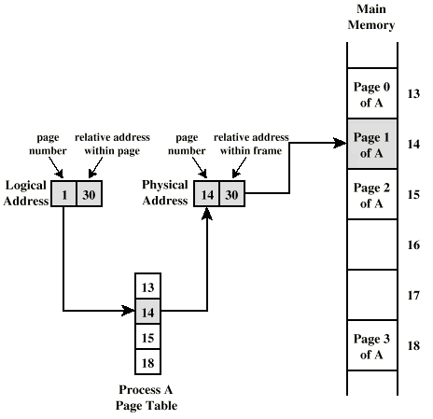
Operating System Support
Memory Management

Slide 226
Operating System Support
Memory Management
Virtual memory
Demand paging
  Do not require all pages of a process in memory
  Bring in pages as required
Page fault
  Required page is not in memory
  Operating system must swap in required page
  May need to swap out a page to make space
  Select page to throw out based on recent history

Slide 227
Operating System Support
Memory Management
Thrashing
  Too many processes in too little memory
  Operating system spends all its time swapping
  Little or no real work is done
  Disk light is on all the time
  Solutions
    Good page replacement algorithms
    Reduce number of processes running
    Fit more memory

Slide 228
Instruction Sets
Overview
Collection of different instructions that the CPU can execute
Boundary where the computer designer and programmer can view the same system
  CPU must provide the functionality specified in the instruction set
    Future processors often limited by backwards compatibility
  Programmer interfaces to the system through the instruction set
    Usually abstracted by compilers
Notes:
2

Slide 229
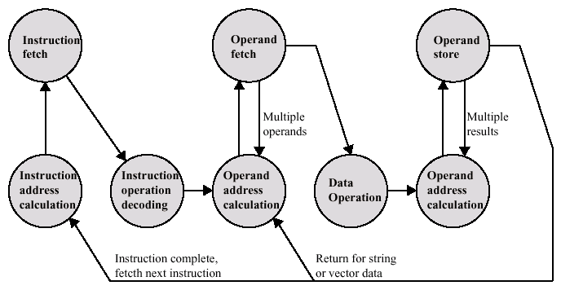
Instruction Sets
Overview
The steps of execution imply the information contained in an instruction
Notes:
2

Slide 230
Instruction Sets
Instruction Elements
Operation code (Op code)
  Type of operation to perform
Source operand(s) reference
  Operation inputs
Result operand reference
  Location to store result
Next instruction reference
  Often implicit by design
Notes:
3

Slide 231
Instruction Sets
Instruction Elements
Operands may be from one of three main areas
  Main or virtual memory
  CPU register
    Very fast processor memory
    Processors typically limited to a 4 – 256 registers total
  I/O device
    Memory mapped I/O just uses a memory address
Notes:
4

Slide 232
Instruction Sets
Instruction Representation
Instructions are stored using unique binary patterns
  Instruction format specifies what data is located where
Binary representations are difficult to understand unless you’re Data
  Symbolic representation are used instead
  e.g. ADD, SUB, LOAD, STOR
Operands can also be represented
  ADD Dest, Src
Notes:
5

Slide 233
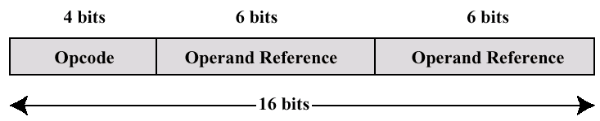
Instruction Sets
Instruction Representation
E.g. instructions are 16-bits long
  Opcode is 4 bits
    0000 = ADD, 0001 = SUB, 0010 = LOAD, …
  Operands are each 6 bits
    Each references a memory region
Notes:
5

Slide 234
Instruction Sets
Instruction Representation
We can categorize instructions into 4 main types
  Data processing – arithmetic and logic instructions
  Data storage – memory instructions
  Data movement – I/O instructions
  Control – test and branch instructions
    Test – compare a variable’s value
    Branch – change the PC
Notes:
6

Slide 235
Instruction Sets
Instruction Representation
Instructions can reference a different number of addresses (operands)
  E.g. 2 operands + 1 result + 1 for next instruction
Most processors can reference 1-3 addresses per instruction
3 addresses
  Operand 1, Operand 2, Result
  a = b + c;
  May be a fourth - next instruction (usually implicit)
  Not common
  Needs very long words to hold everything
Notes:
7

Slide 236
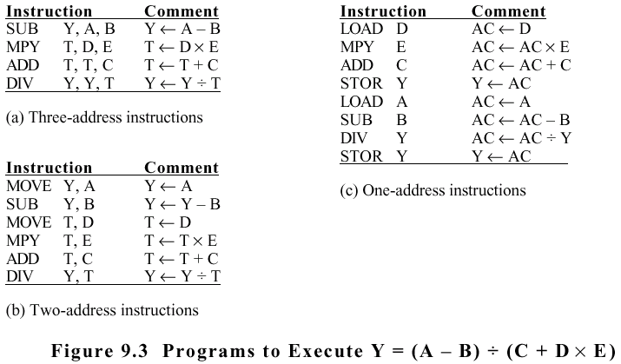
Instruction Sets
Instruction Representation
Notes:
8

Slide 237
Instruction Sets
Instruction Representation
There are several trade-offs when specifying instructions
More addresses
  More complex instructions
    Complicates processor design
  Fewer instructions per program
Fewer addresses
  Less complex instructions
    Simpler processor design
  More instructions per program
Notes:
11

Slide 238
Instruction Sets
Design
Operations
  How many and which operations
  How complex are the operations
Data types
Instruction formats
  Length of op code field
  Number of addresses
  Size of various fields
Notes:
12

Slide 239
Instruction Sets
Design
Registers
  Number of CPU registers that can be referenced
  Use of specific registers
Addressing
RISC versus CISC
Notes:
13

Slide 240
Instruction Sets
Operands
Addresses
  More on later
Numbers
  Integer, floating point, binary coded decimal
Characters
  ASCII etc.
  Often just used as an 8-bit number
Logical Data
  Bits or flags
Notes:
14

Slide 241
Instruction Sets
Operations
Data Transfer
  Move data from one location to another
  E.g. Move, Load, Store, Clear, Exchange
  Specify source, destination, amount of data
  Can have a single instruction (e.g. MOV) or multiple instructions (e.g. MOVMEM, MOVREG )
Notes:
18

Slide 242
Instruction Sets
Operations
Arithmetic
  E.g. Add, Subtract, Multiply, Divide
  Signed and unsigned integers
  Floating point
  May also include
    Increment (++a & a++)
    Decrement (--a & a--)
    Negate (-a)
Notes:
20

Slide 243
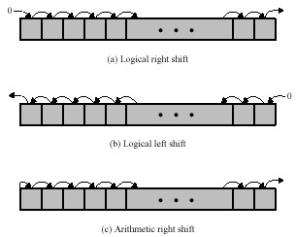
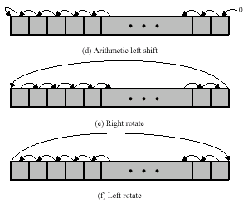
Instruction Sets
Operations
Logical
  E.g. &, ^, ~ (bitwise operators), shift
Notes:
21

Slide 244
Instruction Sets
Operations
Transfer of Control
  Redirect the flow of instructions – changes the PC
  Branch
    E.g. branch to location L if result is zero
  Skip
    E.g. increment and skip if zero
      ISZ Reg1
      Branch L
      ADD A, B
  Subroutine call
    E.g. interrupt call
Notes:
25

Slide 245

Instruction Sets
Operations
Notes:
25

Slide 246
Instruction Sets
Operations
It is often desirable to pass information to a called procedure
Parameters may be placed into memory, where the subroutine looks for it
  Prevents reentrant subroutines
Procedure may also need temporary memory to store its data
Notes:
22

Slide 247
Instruction Sets
Operations
Solution is to use a stack
  Grows up or down in memory
  Each call gets its own location in the stack
  Parameters and local variables are declared on the stack
  Return location from call is also placed on the stack, so procedure knows what to set the PC to when returning
Notes:
22

Slide 248
Instruction Sets
Operations
Conversion
  E.g. Binary to Decimal
Input/output
  E.g. Programmed I/O, DMA
System control
  E.g. status register update
  Usually reserved for OS
Notes:
22

Slide 249
Instruction Sets
Byte Ordering
In order to read data from memory, we need to know how to store data larger than 1 byte
Big-endian – least significant byte in lowest address
  Consistent order, faster sorting
Little-endian – least significant byte in highest address
  Faster address conversion and arithmetic
Notes:
27

Slide 250
Instruction Sets
Byte Ordering
E.g. store 0x12345678 (32-bit number)
Address | Big-Endian | Little-Endian
100 | 12 | 78
101 | 34 | 56
102 | 56 | 34
103 | 78 | 12
Notes:
27

Slide 251
Instruction Sets
Byte Ordering
x86, VAX are little-endian
IBM 370, Motorola, and most RISC are big-endian
Internet is big-endian
  Requires htoi/hton and itoh/ntoh (Host to Internet & Internet to Host) functions to convert from little to big endian
Notes:
30

Slide 252
Addressing Modes
Overview
Would like to be able to reference a large range of locations in memory
Employ a variety of addressing techniques
  Immediate, direct, indirect, register, register indirect, displacement (indexed), stack
Trade-off between address range, flexibility, number of memory references, and complexity of address calculation
Notes:
2

Slide 253
Addressing Modes
Immediate
Operand is part of instruction
Operand = address field
e.g. ADD 5
  Add 5 to contents of accumulator
  5 is operand
No memory reference to fetch data
Fast
Limited range
Notes:
3

Slide 254
Addressing Modes
Immediate
Instruction
Opcode
Operand
Notes:
4

Slide 255
Addressing Modes
Direct
Address field contains address of operand
Effective address (EA) = address field A
e.g. ADD A
  Add contents of cell A to accumulator
  Look in memory at address A for operand
Single memory reference to access data
No additional calculations to work out effective address
Limited address space
Notes:
5

Slide 256
Addressing Modes
Direct
Instruction
Opcode
Address A
Memory
Operand
Notes:
6

Slide 257
Addressing Modes
Indirect
Memory cell pointed to by address field contains the address of (pointer to) the operand
EA = (A)
  Look in A, find address (A) and look there for operand
Large address space
May be nested
  E.g. EA = ((A))
Multiple memory accesses to find operand
Slower
Notes:
7

Slide 258
Addressing Modes
Indirect
Instruction
Opcode
Address A
Memory
Pointer to operand
Operand
Notes:
9

Slide 259
Addressing Modes
Register
Operand is held in register named in address field
EA = R
Limited number of registers
  Requires good assembly or compiler writing
  E.g. register int a;
Very small address field needed
  Shorter instructions
  Faster instruction fetch
No memory access
Very fast execution
Very limited address space
Notes:
10

Slide 260
Addressing Modes
Register
Instruction
Opcode
Register Address R
Registers
Operand
Notes:
12

Slide 261
Addressing Modes
Register Indirect
Similar to indirect addressing
EA = (R)
Operand is in memory cell pointed to by contents of register R
Large address space
One fewer memory access than indirect addressing
Notes:
13

Slide 262
Addressing Modes
Register Indirect
Instruction
Opcode
Register Address R
Memory
Registers
Pointer to Operand
Operand
Notes:
14

Slide 263
Addressing Modes
Displacement Addressing
Combines direct with register indirect
EA = A + (R)
Address field hold two values
  A = base value
  R = register that holds displacement
Three common types
  Relative, base-register, and indexing
Notes:
15

Slide 264
Addressing Modes
Displacement Addressing
Instruction
Opcode
Register R
Address A
Memory
Registers
Pointer to Operand
+
Operand
Notes:
16

Slide 265
Addressing Modes
Relative Displacement
Implicitly references PC as its register
R = Program counter, PC
EA = A + (PC)
I.e. get operand A cells from current location pointed to by PC
Takes advantage of locality of reference and cache usage
Notes:
17

Slide 266
Addressing Modes
Base-Register Displacement
R holds pointer to base address
R may be explicit or implicit
A holds displacement
  E.g. an unsigned integer
Notes:
18

Slide 267
Addressing Modes
Indexed Displacement
Opposite of base-register
A = base
R = displacement
EA = A + R
Good for accessing arrays
  EA = A + R
  R++
So common that most processors provide autoindexing – R++
Notes:
19

Slide 268
Addressing Modes
Stack
Operand is (implicitly) on top of stack
E.g.
  ADD Pop top two items from stack and add
Notes:
21

